Slide 1

凡渡_AWD对抗攻防平台
重庆理工大学计算机科学与工程学院

Slide 2


Slide 3
目录 / Contents
01
AWD比赛介绍
02
项目简介
03
项目架构
04
单击此处输入标题文本

Slide 4
01
AWD比赛介绍

Slide 5



1
AWD比赛简介
AWD(Attack With Defense，攻防兼备)模式是一个非常有意思的模式，你需要在一场比赛里要扮演攻击方和防守方，攻者得分，失守者会被扣分。也就是说，攻击别人的靶机可以获取 Flag 分数时，别人会被扣分，同时你也要保护自己的主机不被别人得分，以防扣分。
​ 也就是说，在AWD比赛中，你既是一个hacker对其他选手的网站进行攻击，获取其服务器权限，又是一个manager对自己的存在漏洞的网站进行维护，防止其他队伍通过漏洞攻陷自己的服务器。
​ 一般来说整个比赛的流程为：
​ 以线下AWD比赛为例（当然现在有很多AWD比赛都是线上进行的了，这样方便在不同地方的团队成员进行训练）
​ 选手来到场地 -> 接网线进内网 -> 主办方分发服务器地址和密码 -> （给网络拓扑，或许吧） -> （给每个队伍一定时间先修补自身服务器漏洞，在此期间不允许相互攻击，感觉大部分是直接进行攻击，不会给初期维护的时间） -> 进行比赛 -> 每轮进行分数结算 -> 比赛结束
​ 所以整个比赛是手速，攻防经验，前期准备，团队分工，选手心态的比拼，在比赛过程中能够较好锻炼参赛选手的反应意识和攻防经验，通过比赛来提升个人的应急响应和攻防对抗技术。

Slide 6
1
AWD比赛赛制
AWD赛制是一种网络安全竞赛的赛制。AWD赛制由安全竞赛专家及行业专家凭借十多年实战经验，将真实网络安全防护设备设施加入抽象的网络环境中，模拟政府、企业、院校等单位的典型网络结构和配置，开展的一种人人对抗的竞赛方式，考验参赛者攻防兼备的能力。其主要特点为：强调实战性、实时性、对抗性，综合考量竞赛队的渗透能力和防护能力。
攻防兼备AWD模式是一种综合考核参赛团队攻击、防御技术能力、即时策略的比赛模式。在攻防模式中，参赛队伍分别防守同样配置的虚拟靶机，并在有限的博弈时间内，找到其他战队的薄弱环节进行攻击，同时要对自己的靶机环境进行加固防守。
比赛采用零和积分方式，即每个战队都拥有相同的起始分数，挖掘网络服务漏洞并攻击对手服务取得flag获得积分，被攻击方扣减相应分数；修补自身服务漏洞进行防御来避免丢分，最终以得分高低直接分出胜负。因为AWD竞赛方式，战队得分情况跟技术水平高低的反馈非常直接，对抗性强，而且选手会在竞赛过程中衍生出各种各样的竞技技巧及战略战术，经验丰富和技术娴熟的选手可以以压倒性的技术收割分数，在CTF选手间拥有较高的口碑。

Slide 7
02
项目简介

Slide 8
1-项目简介-凡渡_AWD对抗攻防平台
AWD(Attack With Defence)比赛是训练网络安全人员在模拟真实环境中互相攻防的新型比赛模式，比赛中每个队伍维护多台服务器，服务器中存在多个漏洞，利用漏洞攻击其他队伍可以进行得分，修复漏洞可以避免被其他队伍攻击失分。凡渡_AWD攻防对抗平台是基于这种比赛模式下，方便各大高校，安全企业，网络安全爱好者搭建运行并磨练自身网络空间对抗技术的开源平台，平台运用docker容器虚拟化技术快速构建复杂度高、隔离性强的各种漏洞环境，方便参赛者复现，理解，利用相关漏洞，从而在比赛中得到学习和进步，同时在Unity编写的实时战斗大屏上显示战斗实况用来展现对抗的激烈程度。

Slide 9
1
单击此处输入标题 / Click here to add your title
单击此处输入标题
I love you more than I've ever loved any woman. And I've waited longer for you than I've waited for any woman.
单击此处输入标题
I love you more than I've ever loved any woman. And I've waited longer for you than I've waited for any woman.
单击此处输入标题
I love you more than I've ever loved any woman. And I've waited longer for you than I've waited for any woman.

Slide 10
2
项目简介——安装方式
2、Docker安装
1、源码安装

Slide 11
2
项目简介——源码安装
4.
修改config.py数据库账号密码为本地账号密码，创建MySQL数据库fandu_awd
1.
准备好环境，Python版本:3.X，数据库:MySQL
5.
初始化数据库，数据库导入 init.sql 文件
2.
从github下载源代码：git clone https://github.com/Cl0udG0d/testAWD
6.
3.
运行python3 index.py，浏览器输入127.0.0.1:5000 访问AWD攻防对抗平台
安装python所需要的库文件 cd testAWD && pip3 install -r requirements.txt

Slide 12
03
项目架构

Slide 13
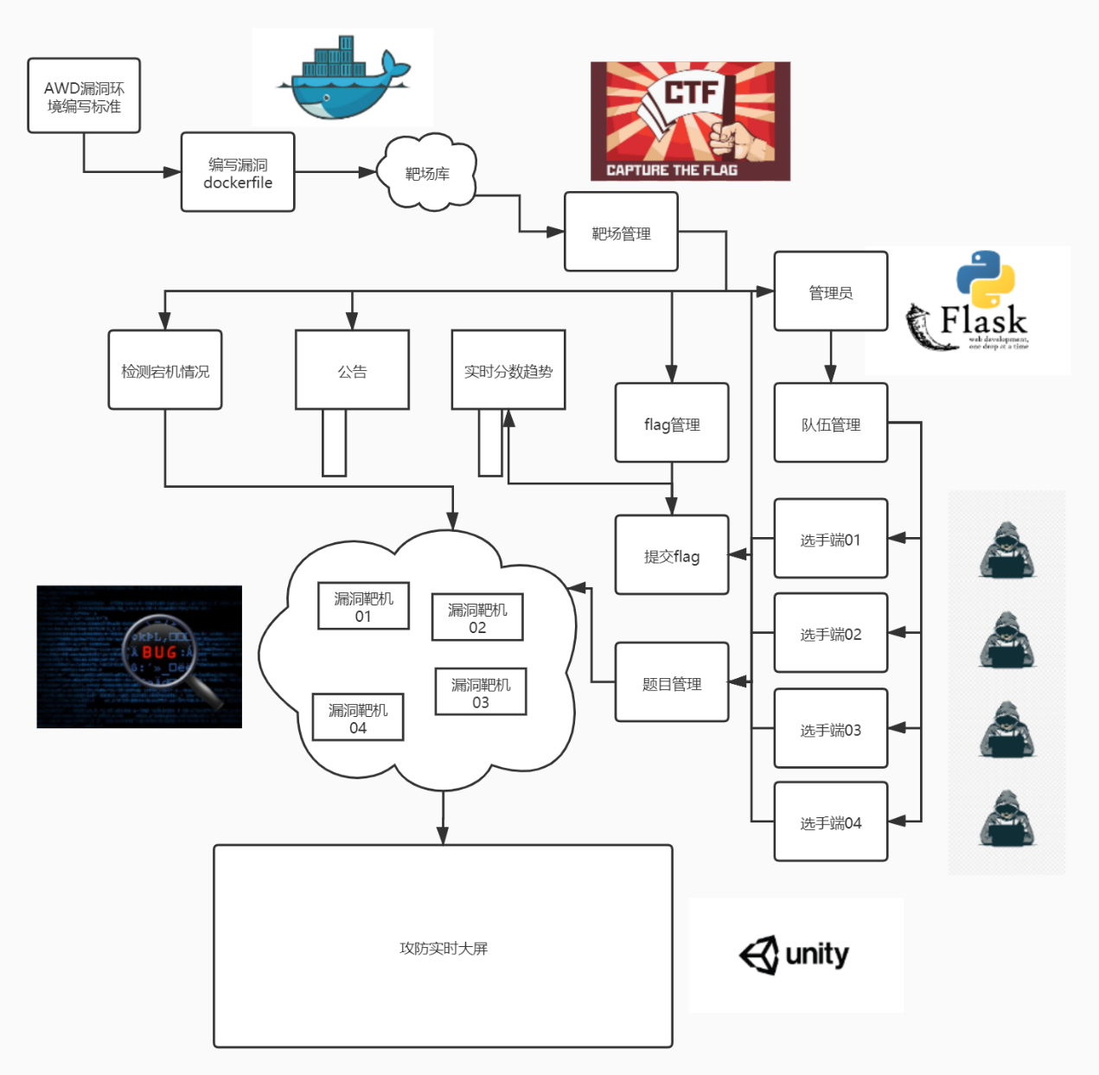
3
项目架构-架构图

Slide 14
1
单击此处输入标题 / Click here to add your title
单击此处输入标题
单击此处输入标题
I love you more than I've ever loved any woman. And I've waited longer for you than I've waited for any woman.
I love you more than I've ever loved any woman. And I've waited longer for you than I've waited for any woman.
单击此处输入标题
单击此处输入标题
I love you more than I've ever loved any woman. And I've waited longer for you than I've waited for any woman.
I love you more than I've ever loved any woman. And I've waited longer for you than I've waited for any woman.

Slide 15

1
单击此处输入标题 / Click here to add your title
单击此处输入标题
When a cigarette falls in love with a match,it is destined to be hurt.When a cigarette falls in love with a match,it is destined to be hurt.
When a cigarette falls in love with a match,it is destined to be hurt.When a cigarette falls in love with a match,it is destined to be hurt.When a cigarette falls in love with a match,it is destined to be hurt.When a cigarette falls in love with a match,it is destined to be hurt.

Slide 16
1
单击此处输入标题 / Click here to add your title
输入标题
输入标题
输入标题
When a cigarette falls in love with a match,it is destined to be hurt.
When a cigarette falls in love with a match,it is destined to be hurt.
When a cigarette falls in love with a match,it is destined to be hurt.
单击此处输入标题文本
I love you more than I've ever loved any woman. And I've waited longer for you than I've waited for any woman.I love you more than I've ever loved any woman. And I've waited longer for you than I've waited for any woman.

Slide 17
1
单击此处输入标题 / Click here to add your title
输入标题
I love you more than I've ever loved any woman. And I've waited longer for you than I've waited for any woman.
I love you more than I've ever loved any woman. And I've waited longer for you than I've waited for any woman.
I love you more than I've ever loved any woman. And I've waited longer for you than I've waited for any woman.
I love you more than I've ever loved any woman. And I've waited longer for you than I've waited for any woman.

Slide 18




1
单击此处输入标题 / Click here to add your title
单击此处输入标题
单击此处输入标题
I love you more than I've ever loved any woman. And I've waited longer for you than I've waited for any woman.
I love you more than I've ever loved any woman. And I've waited longer for you than I've waited for any woman.
单击此处输入标题
单击此处输入标题
I love you more than I've ever loved any woman. And I've waited longer for you than I've waited for any woman.
I love you more than I've ever loved any woman. And I've waited longer for you than I've waited for any woman.

Slide 19
1
单击此处输入标题 / Click here to add your title
85%
73%
78%
90%
单击此处输入标题
I love you more than I've ever loved any woman. And I've waited longer for you than I've waited for any woman.
单击此处输入标题
I love you more than I've ever loved any woman. And I've waited longer for you than I've waited for any woman.
单击此处输入标题
I love you more than I've ever loved any woman. And I've waited longer for you than I've waited for any woman.
单击此处输入标题
I love you more than I've ever loved any woman. And I've waited longer for you than I've waited for any woman.

Slide 20

1
单击此处输入标题 / Click here to add your title
单击此处输入标题
I love you more than I've ever loved any woman. And I've waited longer for you than I've waited for any woman.
I love you more than I've ever loved any woman. And I've waited longer for you than I've waited for any woman.
I love you more than I've ever loved any woman. And I've waited longer for you than I've waited for any woman.I love you more than I've ever loved any woman. And I've waited longer for you than I've waited for any woman.

Slide 21
1
单击此处输入标题 / Click here to add your title
单击此处输入标题
单击此处输入标题
I love you more than I've ever loved any woman. And I've waited longer for you than I've waited for any woman.
I love you more than I've ever loved any woman. And I've waited longer for you than I've waited for any woman.
单击此处输入标题
单击此处输入标题
I love you more than I've ever loved any woman. And I've waited longer for you than I've waited for any woman.
I love you more than I've ever loved any woman. And I've waited longer for you than I've waited for any woman.

Slide 22
03
单击此处输入标题文本
Remember what should be remembered, and forget what should be forgotten.Remember what should be remembered, and forget what should be forgotten.

Slide 23
1
单击此处输入标题 / Click here to add your title
单击此处输入标题
单击此处输入标题
I love you more than I've ever loved any woman. And I've waited longer for you than I've waited for any woman.
单击此处输入标题
I love you more than I've ever loved any woman. And I've waited longer for you than I've waited for any woman.
单击此处输入标题
I love you more than I've ever loved any woman. And I've waited longer for you than I've waited for any woman.

Slide 24
1
单击此处输入标题 / Click here to add your title
单击此处输入标题
单击此处输入标题
单击此处输入标题
单击此处输入标题
I love you more than I've ever loved any woman. And I've waited longer for you than I've waited for any woman.I love you more than I've ever loved any woman. And I've waited longer for you than I've waited for any woman.

Slide 25

1
单击此处输入标题 / Click here to add your title
单击此处输入标题
I love you more than I've ever loved any woman. And I've waited longer for you than I've waited for any woman.
单击此处输入标题
I love you more than I've ever loved any woman. And I've waited longer for you than I've waited for any woman.

Slide 26
1
单击此处输入标题 / Click here to add your title
单击此处输入标题
I love you more than I've ever loved any woman. And I've waited longer for you than I've waited for any woman.
单击此处输入标题
I love you more than I've ever loved any woman. And I've waited longer for you than I've waited for any woman.
单击此处输入标题
I love you more than I've ever loved any woman. And I've waited longer for you than I've waited for any woman.
单击此处输入标题
I love you more than I've ever loved any woman. And I've waited longer for you than I've waited for any woman.

Slide 27
04
单击此处输入标题文本
Remember what should be remembered, and forget what should be forgotten.Remember what should be remembered, and forget what should be forgotten.

Slide 28
1
单击此处输入标题 / Click here to add your title
单击此处输入标题
单击此处输入标题
I love you more than I've ever loved any woman. And I've waited longer for you than I've waited for any woman.
单击此处输入标题
I love you more than I've ever loved any woman. And I've waited longer for you than I've waited for any woman.
单击此处输入标题
I love you more than I've ever loved any woman. And I've waited longer for you than I've waited for any woman.

Slide 29
1
单击此处输入标题 / Click here to add your title
单击此处输入标题
I love you more than I've ever loved any woman. And I've waited longer for you than I've waited for any woman.
单击此处输入标题
I love you more than I've ever loved any woman. And I've waited longer for you than I've waited for any woman.
单击此处输入标题
I love you more than I've ever loved any woman. And I've waited longer for you than I've waited for any woman.

Slide 30
1
单击此处输入标题 / Click here to add your title
单击此处输入标题
I love you more than I've ever loved any woman. And I've waited longer for you than I've waited for any woman.
单击此处输入标题
I love you more than I've ever loved any woman. And I've waited longer for you than I've waited for any woman.
单击此处输入标题
I love you more than I've ever loved any woman. And I've waited longer for you than I've waited for any woman.

Slide 31
THANK YOU
When a cigarette falls in love with a match,it is destined to be hurt.When a cigarette falls in love with a match,it is destined to be hurt.

